Slide 1
Super Computing Express Services in High-performance WAN
Jie Liang, liangjie6@chinatelecom.cn
Huiyue Zhang, zhanghy30@chinatelecom.cn
IETF-120 : Vancouver , July 2024

Slide 2
Contents
Requirements of massive data transmission
Solution: Super Computing Express of HP WAN

Slide 3
Requirements of massive data transmission
The primary goal is to ensure the effective high-throughput transmission of massive data.
Transmission Requirement:
Throughput = min{BW,WindowSize/RTT,(MSS/RTT)*(1/P))
R1: High bandwidth
R2: Low latency
R3: Extremely low or zero packet loss ratio
R4: Stable R1,R2,R3 during service time
Requirements
R5: Task-based
Low cost for users
R6: Elastic SLA
Cost Requirement: low cost
R7: Elastic time
Low cost for operators
R8: Utilizing IP statistical multiplexing features
Security Requirement:
R9: Security

Slide 4
Current solutions and their drawbacks
Solutions | R1: High bandwidth | R2: Low latency | R3: Extremely low or zero packet loss ratio | R4: Stable R1,R2,R3 during service time | R5: Task-based | R6: Elastic SLA | R7: Elastic time | R8: statistical multiplexing | R9: Security
Hard disk | × | × | √ | × | √ | × | × | × | ×
Dedicated leased line | Some of it will satisfy | √ | √ | √ | × | × | × | × | √
？ | √ | √ | √ | √ | √ | √ | √ | √ | √
Therefore, we need a solution for massive data transmission with features such as low-cost, large bandwidth, task-based, elastic SLA and secure, to meet all the above requirements.

Slide 5
Solution: Super Computing Express
IP Core Network
IP Core Network
Underlay Network
PPPoEoSRv6
PPPoEoSRv6
Network slicing
Super GW
Network slicing
Super GW
ONU
OLT
ONU
Customer
Customer
OLT
Network slicing
R1:High Bandwidth
Based on the network slicing and SRv6 technology, traffic is diverted to different slices, such as low-latency and large-bandwidth network slices, to achieve differentiated SLA services.
R2: Low latency
R3: low packet loss ratio
Network layer （not application layer）Congestion Control based on bus-based networking and network access mechnism: SLA resource incluing bandwidth,delay,packet loss, time slot and so on will be reserved for a customer and no other customers are permitted to use until the service is terminated.
R4: Stable R1,R2,R3
R5: Task-based
Flow-based Network Monitoring includes Real-time measurement of traffic delay and packet loss based on IOAM technology.
R6: Elastic SLA
Based on the IPC's capability of connection control and service network coordination, it can meet users' demand for flexible bandwidth and on-demand use.
R7: Elastic time
R8: statistical multiplexing
Based on the high-speed PON+IP network, it can realize large bandwidth, low cost, wide coverage and make full use of operators' existing network resources.
R9: Security

Slide 6
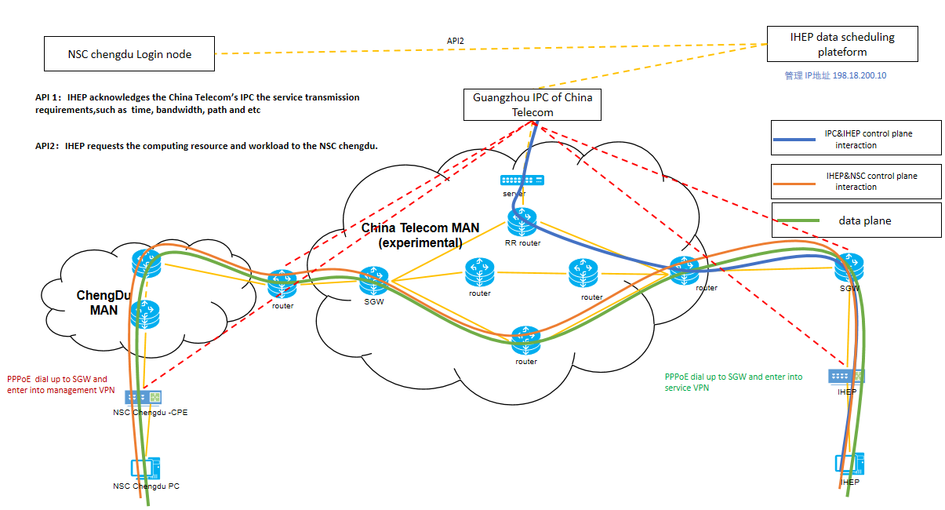
Solution: Super Computing Express
On March 6, 2024, the National Supercomputing Center Chengdu (NSC Chengdu), together with the Institute of High Energy Physics (IHEP) of the Chinese Academy of Sciences (CAS),The Research Institute of China Telecom(CTRI), Beijing branch of China Telecom, Sichuan branch of China Telecom, etc., launched the "Supercomputing Express" service provided by China Telecom. China Telecom provides a cross-domain 10G data line on the metropolitan area network (MAN) of CTRI and completing the first validation of fast data transmission from the customer side to the National Supercomputing Center Chengdu in 40 minutes for the first time across 2,000 kilometers to transfer 1.6TB of data. This verification fully verifies the capability of "Super Computing Express".
Elastic scaling of bandwidth between 30M and 10G
The service type is flexibly switched between "best effort" and "low-latency"
The bidirectional latency is reduced by 55% from 72ms to 32ms
Stable throughput of 8 Gbps during service time

Slide 7
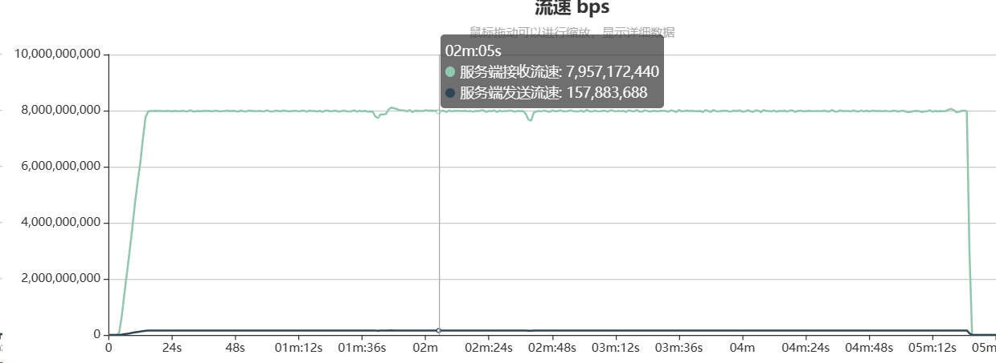
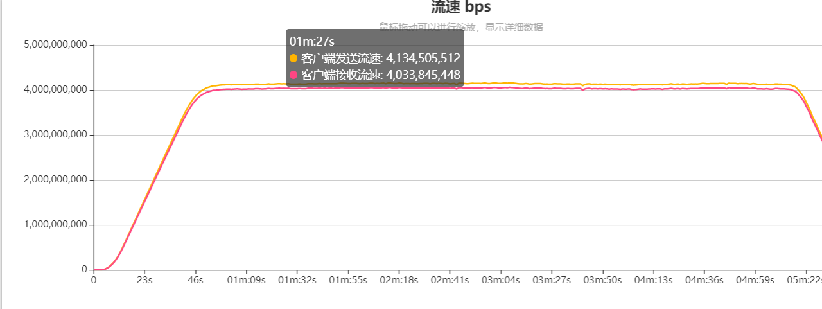
Super Computing Express: high bandwidth utilization
Experiment I:
The bandwidth capacity is 10Gbps
8Gbps of upstream traffic from client to server
Experiment II:
The bandwidth capacity is 10Gbps
4Gbps of upstream traffic and 4Gbps of downstream traffic between server and client
Result：
The server receiving traffic can be stabilized at 8Gbps.
80% bandwidth utilization rate
Result：
Traffic stabilized at 4Gbps upstream and downstream respectively.
80% bandwidth utilization rate

Slide 8
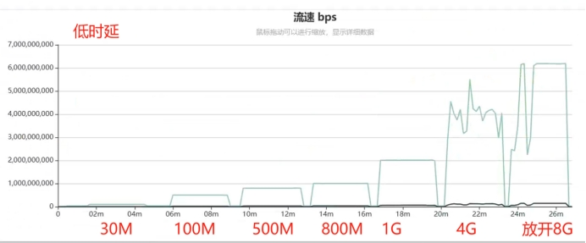
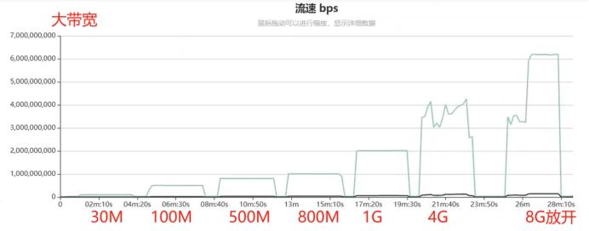
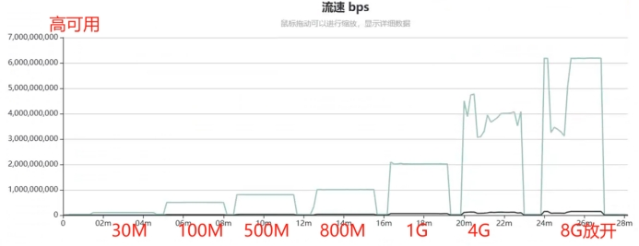
Super Computing Express: SLA services and elastic bandwidth
Experiment III:
The bandwidth capacity is 10Gbps, and the initial traffic limit is 30Mbps.
6Gbps of upstream traffic from client to server
Three link types: low latency, large bandwidth, and high availability, and 100M/500M/800M/1G/2G/4G/8G speed limiting on each type of link.
The result of low latency links
The result of large bandwidth links
Result：
The server can only receive 30Mbps traffic initially.
It can be gradually stabilized at the limited bandwidth.
The result of high availability links

Slide 9
Future work
RDMA technology for extremely low packet loss rates.
Data synchronization between data centers over a distance of 2000km based on RDMA.

Slide 10
Thank You & Let’s discuss

